Slide 1

Testing your Javascript isn’t magic!
Harold Pulcher
pulcher@pulcher.biz
http://pulcher.biz
https://github.com/pulcher/jmagic

Slide 2
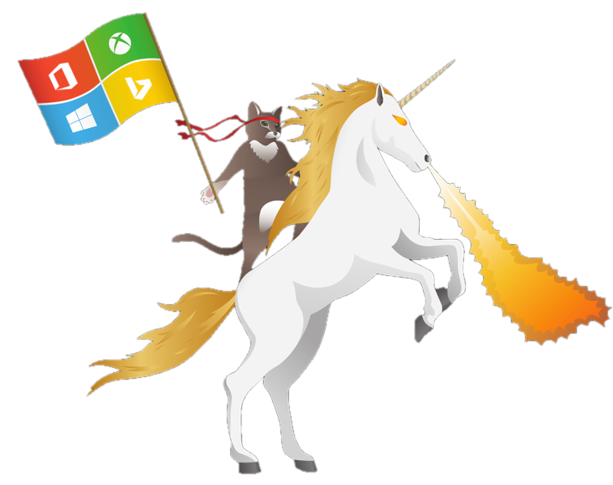
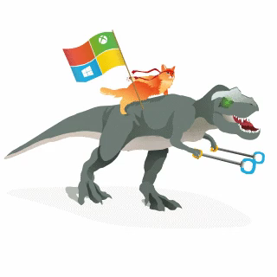
Become a Windows Insider!
https://insider.windows.com/

Slide 3


Slide 4
Why this talk?
Javascript is a first class citizen
Tons of Misconceptions
Show how hard this isn’t

Slide 5
Today’s Menu
Why do we test?
My Sandbox
Server side
Client side

Slide 6
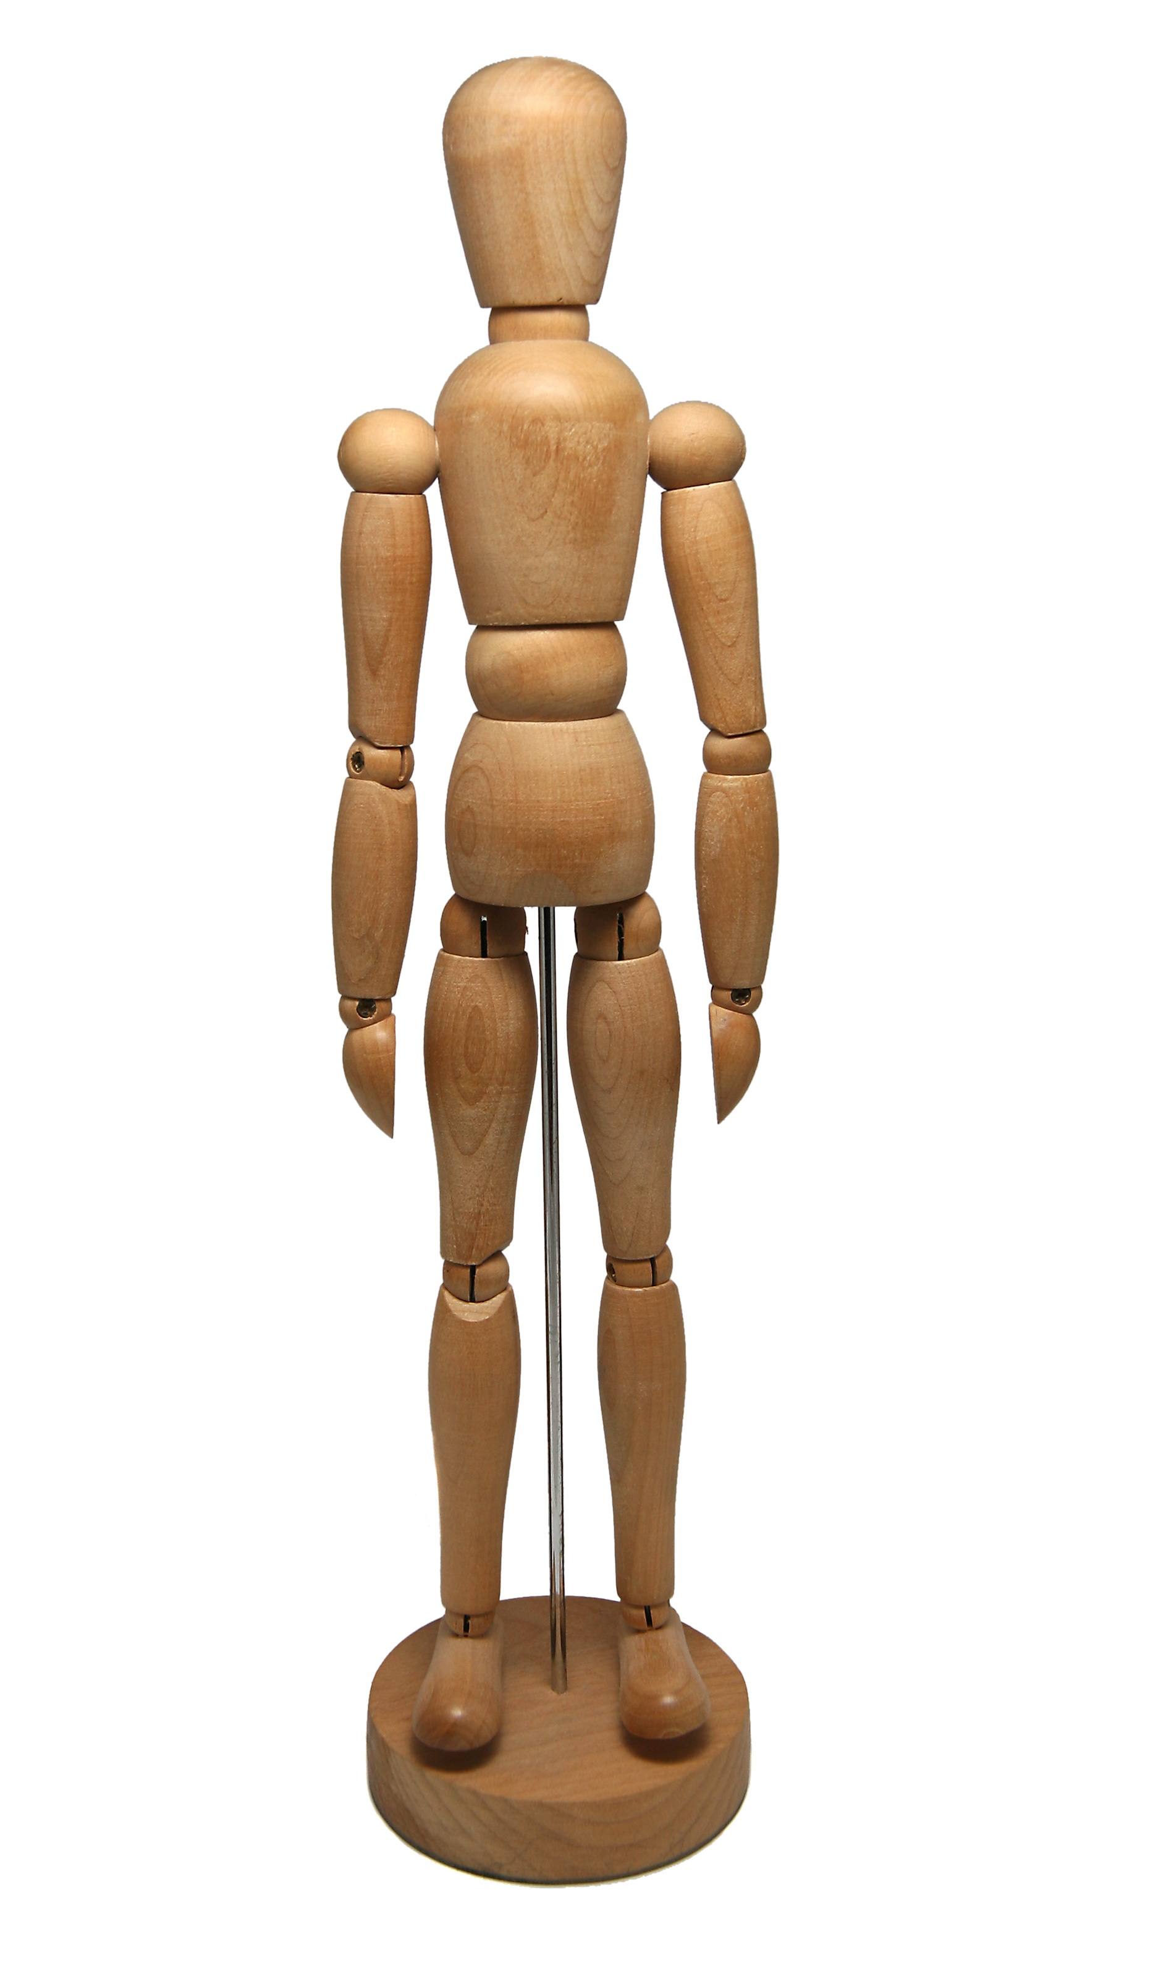
Show me where on the Doll Javascript has touched you.

Slide 7
Why do we test?
“The act of writing a unit test is more an act of design than of verification.
It is also more an act of documentation than of verification. The act of writing a unit test closes a remarkable number of feedback loops, the least of which is the one pertaining to verification of function”
–Martin Fowler

Slide 8
Why do we really test?
“All software is tested. It is just a matter of where.”
–Richard Campbell
(at least that is where I heard it)

Slide 9
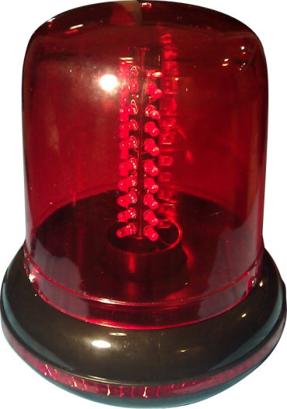
Why do we really test?
Prevents the “Works on my machine” error
Provides developer confidence
Just how fragile(crappy) is your code?
Better written code
sirenofshame.com

Slide 10
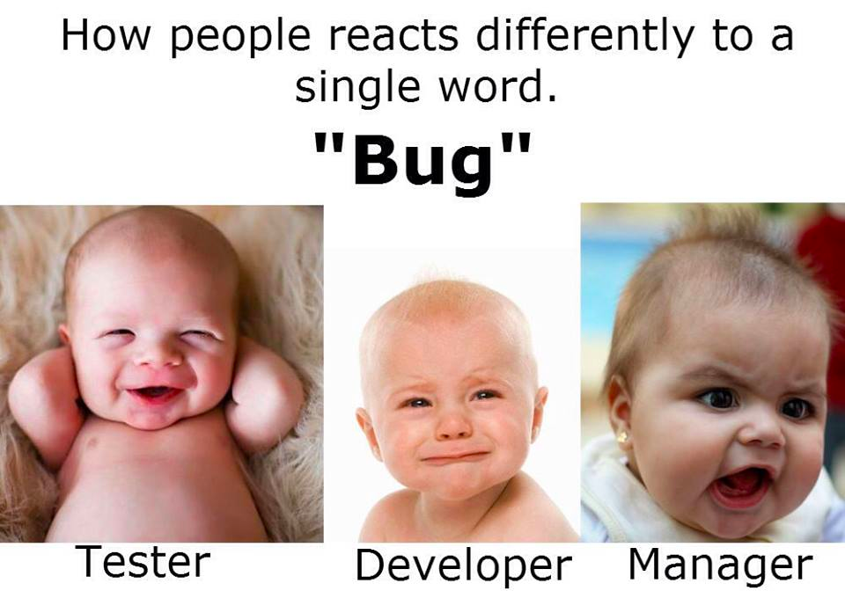

Slide 11
Why do we really test?
Because you sleep!
<demo time>

Slide 12
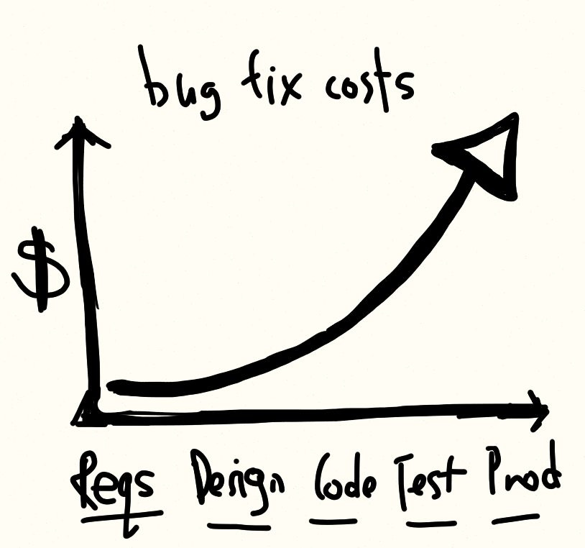
When should you write a test?
Every bug
Edge cases
Complicated features
To learn
and…

Slide 13
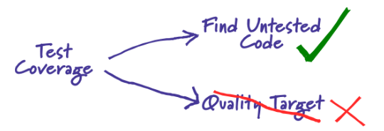
Because someone wants a metric!
–Martin Fowler

Slide 14
My sandbox
Node
Grunt/Gulp + cli
Bower
Ubuntu 14.04 LTS
Git
Yeomen
<demo time>

Slide 15
Server side
Mocha
Istanbul
<demo time>

Slide 16
Client Side
Karma
Jasmine
Protractor
Casper
Phantom
<demo time>

Slide 17
Links
http://nodejs.org/
http://yeoman.io
http://gruntjs.com/getting-started
http://gulpjs.com/
http://mochajs.org/
http://chaijs.com/

Slide 18
Links
https://babeljs.io/
https://github.com/gotwarlost/istanbul
http://karma-runner.github.io/
https://github.com/angular/protractor
http://casperjs.org/
http://phantomjs.org/

